Slide 1
Pointer Incrementing
1

Slide 2
What do these do?
*pList++
(*pList)++
*(pList)++
*(pList++)
*(++pList)
*++pList
(*++)pList
++*pList
++(*pList)
(++*)pList
2

Slide 3
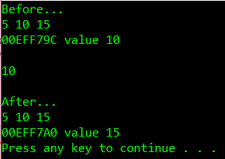
int main() {
int myList[] = { 5,10,15 },
*pList = &myList[1];
cout << "Before...\n" << myList[0] << " " << myList[1] << " " << myList[2] << endl;
cout << pList << " value " << *pList << endl;
cout << endl << *pList++ << endl << endl;
cout << "After...\n" << myList[0] << " " << myList[1] << " " << myList[2] << endl;
cout << pList << " value " << *pList << endl;
system("pause");
return -5;
}
summary: *pList++ retrieves value then advances pointer

Slide 4
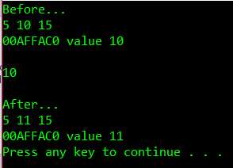
int main() {
int myList[] = { 5,10,15 },
*pList = &myList[1];
cout << "Before...\n" << myList[0] << " " << myList[1] << " " << myList[2] << endl;
cout << pList << " value " << *pList << endl;
cout << endl << (*pList)++ << endl << endl;
cout << "After...\n" << myList[0] << " " << myList[1] << " " << myList[2] << endl;
cout << pList << " value " << *pList << endl;
system("pause");
return -5;
}
summary: (*pList)++ retrieves value then increments contents

Slide 5
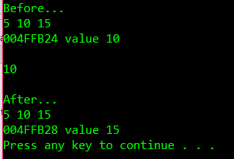
int main() {
int myList[] = { 5,10,15 },
*pList = &myList[1];
cout << "Before...\n" << myList[0] << " " << myList[1] << " " << myList[2] << endl;
cout << pList << " value " << *pList << endl;
cout << endl << *(pList)++ << endl << endl;
cout << "After...\n" << myList[0] << " " << myList[1] << " " << myList[2] << endl;
cout << pList << " value " << *pList << endl;
system("pause");
return -5;
}
summary: *(pList)++ retrieves value then advances pointer

Slide 6
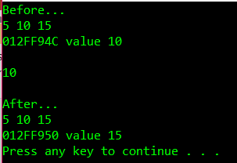
int main() {
int myList[] = { 5,10,15 },
*pList = &myList[1];
cout << "Before...\n" << myList[0] << " " << myList[1] << " " << myList[2] << endl;
cout << pList << " value " << *pList << endl;
cout << endl << *(pList++) << endl << endl;
cout << "After...\n" << myList[0] << " " << myList[1] << " " << myList[2] << endl;
cout << pList << " value " << *pList << endl;
system("pause");
return -5;
}
summary: *(pList++) retrieves value then advances pointer

Slide 7
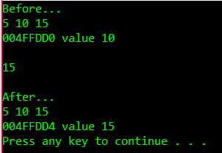
int main() {
int myList[] = { 5,10,15 },
*pList = &myList[1];
cout << "Before...\n" << myList[0] << " " << myList[1] << " " << myList[2] << endl;
cout << pList << " value " << *pList << endl;
cout << endl << *(++pList) << endl << endl;
cout << "After...\n" << myList[0] << " " << myList[1] << " " << myList[2] << endl;
cout << pList << " value " << *pList << endl;
system("pause");
return -5;
}
summary: *(++pList) advances pointer then retrieves value

Slide 8
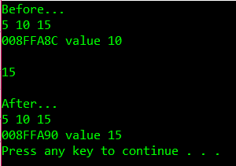
int main() {
int myList[] = { 5,10,15 },
*pList = &myList[1];
cout << "Before...\n" << myList[0] << " " << myList[1] << " " << myList[2] << endl;
cout << pList << " value " << *pList << endl;
cout << endl << *++pList << endl << endl;
cout << "After...\n" << myList[0] << " " << myList[1] << " " << myList[2] << endl;
cout << pList << " value " << *pList << endl;
system("pause");
return -5;
}
summary: *++pList advances pointer then retrieves value

Slide 9

int main() {
int myList[] = { 5,10,15 },
*pList = &myList[1];
cout << "Before...\n" << myList[0] << " " << myList[1] << " " << myList[2] << endl;
cout << pList << " value " << *pList << endl;
cout << endl << (*++)pList << endl << endl;
cout << "After...\n" << myList[0] << " " << myList[1] << " " << myList[2] << endl;
cout << pList << " value " << *pList << endl;
system("pause");
return -5;
}
summary: (*++)pList doesn’t compile

Slide 10
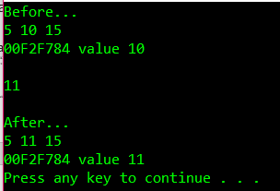
int main() {
int myList[] = { 5,10,15 },
*pList = &myList[1];
cout << "Before...\n" << myList[0] << " " << myList[1] << " " << myList[2] << endl;
cout << pList << " value " << *pList << endl;
cout << endl << ++*pList << endl << endl;
cout << "After...\n" << myList[0] << " " << myList[1] << " " << myList[2] << endl;
cout << pList << " value " << *pList << endl;
system("pause");
return -5;
}
summary: ++*pList increments current contents

Slide 11
int main() {
int myList[] = { 5,10,15 },
*pList = &myList[1];
cout << "Before...\n" << myList[0] << " " << myList[1] << " " << myList[2] << endl;
cout << pList << " value " << *pList << endl;
cout << endl << ++(*pList) << endl << endl;
cout << "After...\n" << myList[0] << " " << myList[1] << " " << myList[2] << endl;
cout << pList << " value " << *pList << endl;
system("pause");
return -5;
}
summary: ++(*pList) increments current contents

Slide 12
int main() {
int myList[] = { 5,10,15 },
*pList = &myList[1];
cout << "Before...\n" << myList[0] << " " << myList[1] << " " << myList[2] << endl;
cout << pList << " value " << *pList << endl;
cout << endl << (++*)pList << endl << endl;
cout << "After...\n" << myList[0] << " " << myList[1] << " " << myList[2] << endl;
cout << pList << " value " << *pList << endl;
system("pause");
return -5;
}
summary: (++*)pList doesn’t compile

Slide 13
Summary of summaries:
*pList++ retrieves value then advances pointer
(*pList)++ retrieves value then increments contents
*(pList)++ retrieves value then advances pointer
*(pList++) retrieves value then advances pointer
*(++pList) advances pointer then retrieves value
*++pList advances pointer then retrieves value
(*++)pList doesn’t compile
++*pList increments current contents
++(*pList) increments current contents
(++*)pList doesn’t compile

Slide 14
Summary of summaries:
*pList++ retrieves value then advances pointer
*(pList)++ retrieves value then advances pointer
*(pList++) retrieves value then advances pointer
(*pList)++ retrieves value then increments contents
*(++pList) advances pointer then retrieves value
*++pList advances pointer then retrieves value
++*pList increments current contents
++(*pList) increments current contents
(*++)pList doesn’t compile
(++*)pList doesn’t compile

